Slide 1

Introduction to software testing
Definition and Purpose.
Role in Software Development Lifecycle (SDLC).

Slide 2
What is Software Testing?
Software testing is the process of examining the behaviour of the software under test by validation and verification

Slide 3
What is purpose of Testing?
The primary goal of software testing is to identify defects and errors in software applications before they are released to end-users. By detecting and fixing issues early in the development process, testing helps to improve the overall quality of the software and minimize risks associated with its use.

Slide 4
Role in Software Development Lifecycle (SDLC)
Software testing is crucial throughout the Software Development Lifecycle (SDLC), ensuring software meets requirements and functions correctly.
Minimizes development risks by detecting defects early, preventing costly errors.
It provides early feedback to enhance software quality, reliability, and usability, boosting satisfaction.

Slide 5
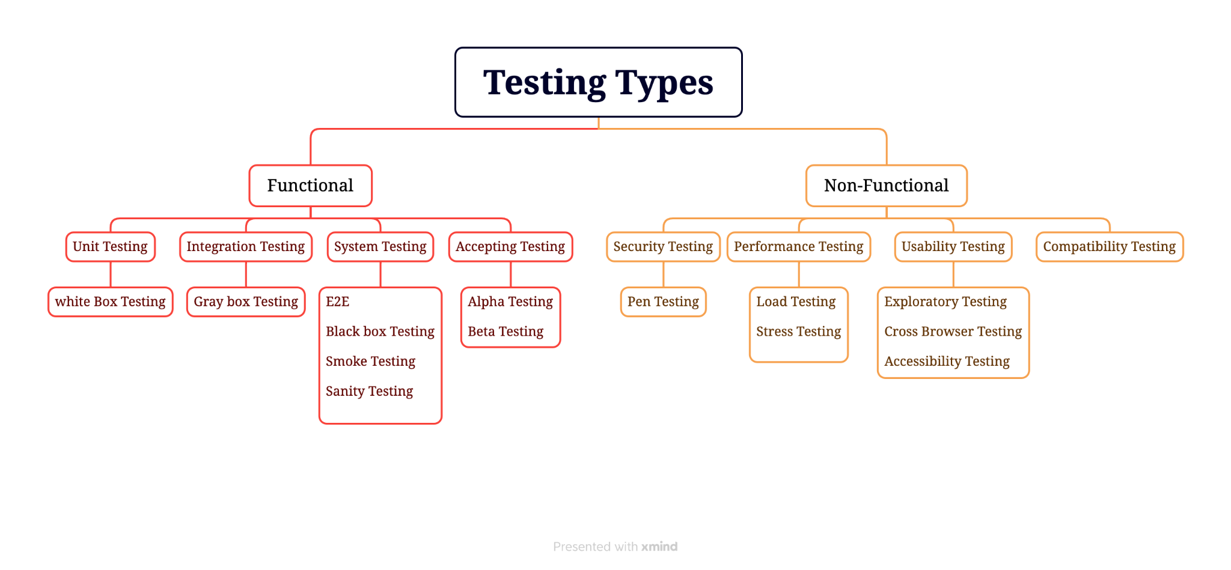
Types of Software Testing

Slide 6
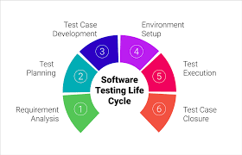
Software Testing Life Cycle (STLC)
The Software Testing Life Cycle (STLC) ensures software quality through different phases
Requirement Analysis: Understanding functional and non-functional requirements.
Test Planning: Outlining test strategy, timelines, and resources.
Test Case Development: Creating detailed test cases based on requirements.
Test Environment Setup: Preparing a testing environment mirroring production.
Test Execution: Running test cases in the testing environment.
Test Closure: Reporting results and officially concluding testing.

Slide 7



Importance of Software Testing
The goal of software testing is to find errors, gaps, or missing requirements in comparison to the actual requirements.

Slide 8
How Software Testing helps organization
Helps in saving money.
Quality of the product.
Satisfaction of the customer.
Determining the performance of the software.
Enhancing the development process.

Slide 9
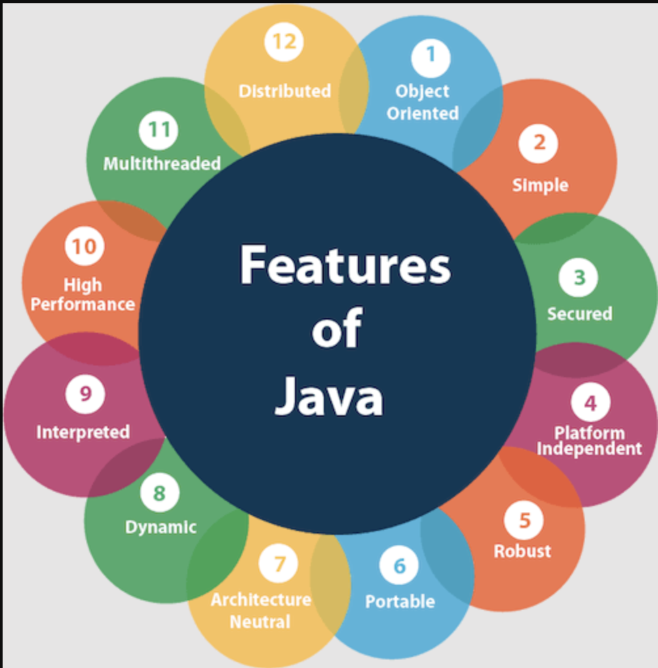
Introduction to Java
Java is a class-based object-oriented programming language.It is created by James Gosling and it was product of Sun MicroSystem then later acquired by Oracle.

Slide 10
The basic concepts of OOPs are
Object
Class
Inheritance
Polymorphism
Abstraction
Encapsulation

Slide 11
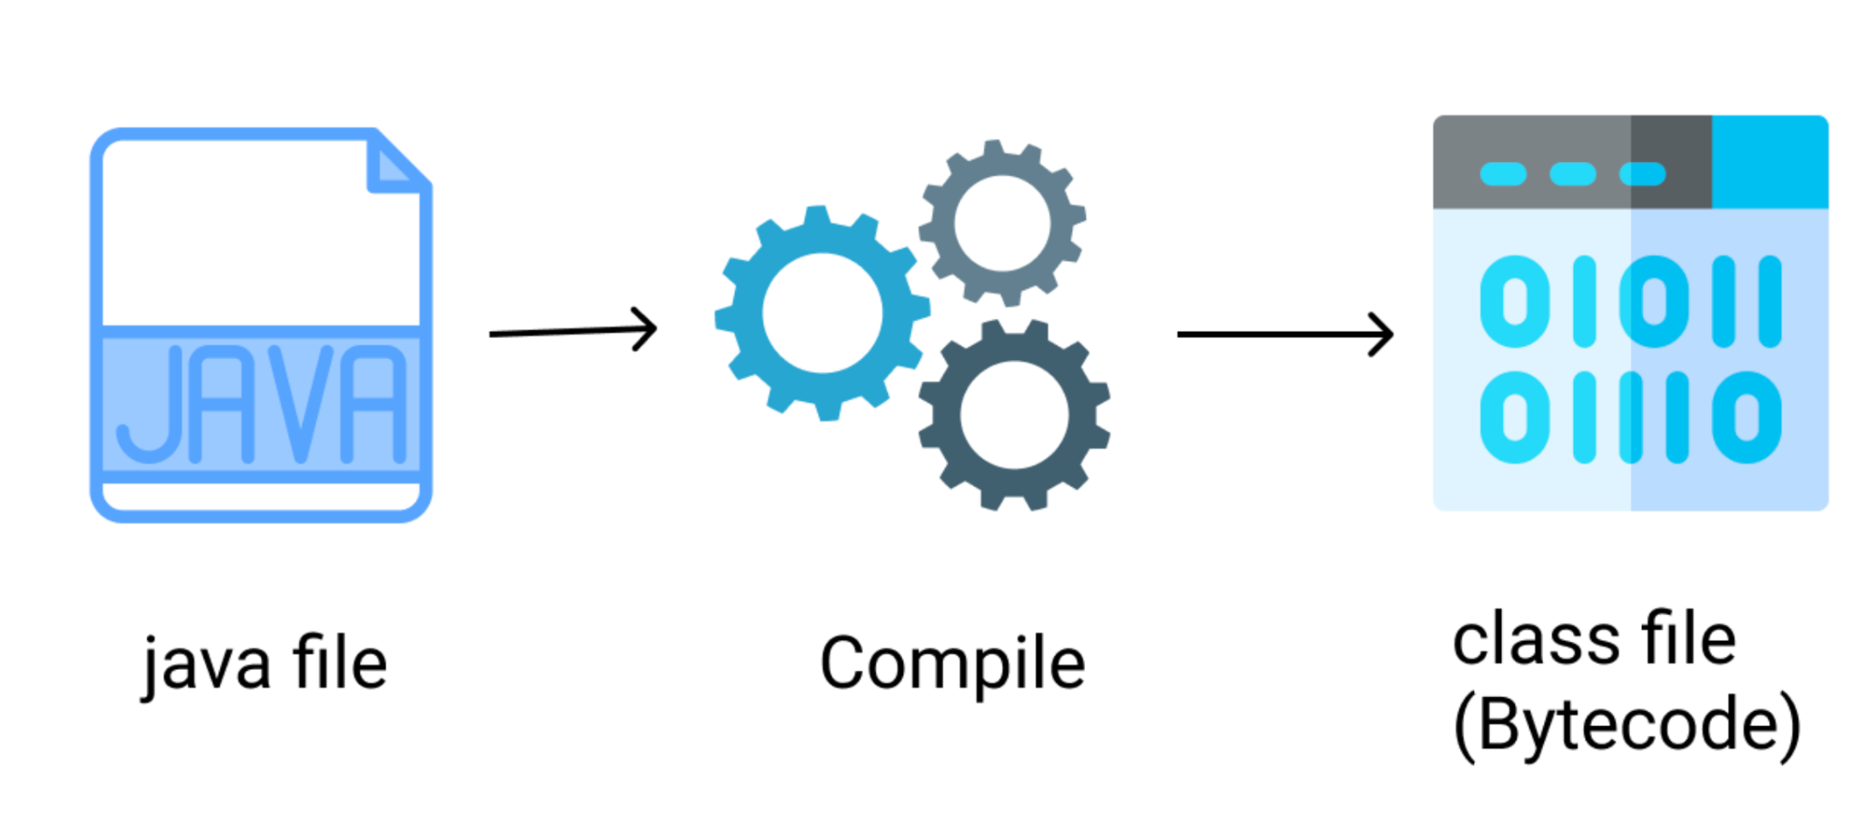
Java Program Compilation

Slide 12
What is Variable
A variable is a container which holds the value while the Java program is executed. A variable is assigned with a data type. Variable is a name of memory location. There are three types of variables in java: local, instance and static.

Slide 13
What is Data Type
Data types are different sizes and values that can be stored in the variable.
Lets understand Data Types and variable in detail

Slide 14
Types of Data Type
Primitive Data Types:
int: Integer values (e.g., 5)
double: Floating-point values (e.g., 3.14)
boolean: True or false values (e.g., true)
char: Single characters (e.g., 'A')
byte: Small integer values (e.g., 10)
short: Larger integer values (e.g., 100)
long: Large integer values (e.g., 1000000)

Slide 15
Types of Data Type
Non Primitive Data Types: These are data types that are derived from classes and include:
String: Represents a sequence of characters (e.g., "Hello, World!")
Arrays: Collections of elements of the same data type (e.g., int[], double[])
Classes and Objects: Custom data types created by the programmer.

Slide 16
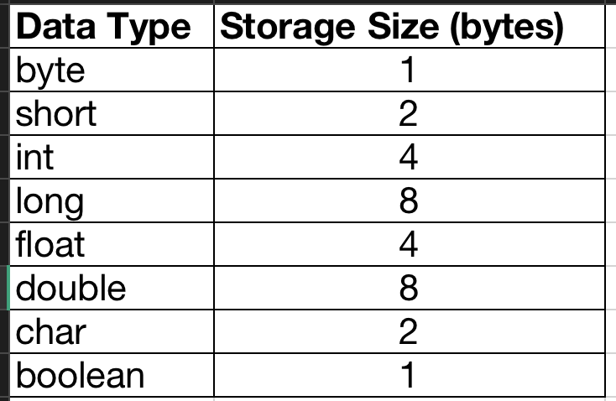
Data Type and storage capacity

Slide 17
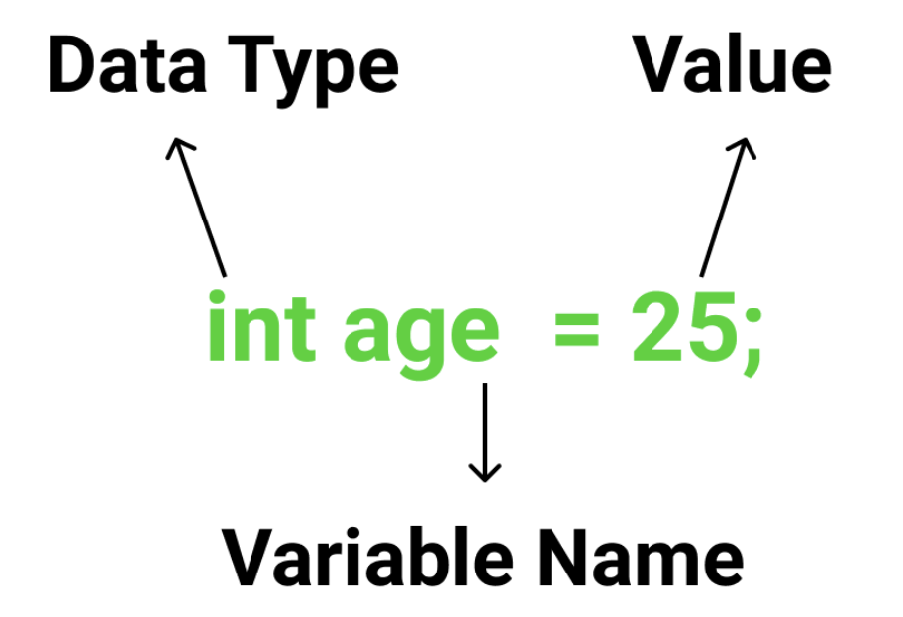

Slide 18
Lets understand conditional statement & Decision making
Decision Making in programming is similar to decision-making in real life. In programming also face some situations where we want a certain block of code to be executed when some condition is fulfilled.

Slide 19
Java's decision making and selection statements:
if
if-else
nested-if
if-else-if
switch-case
jump - break, continue, return

Slide 20
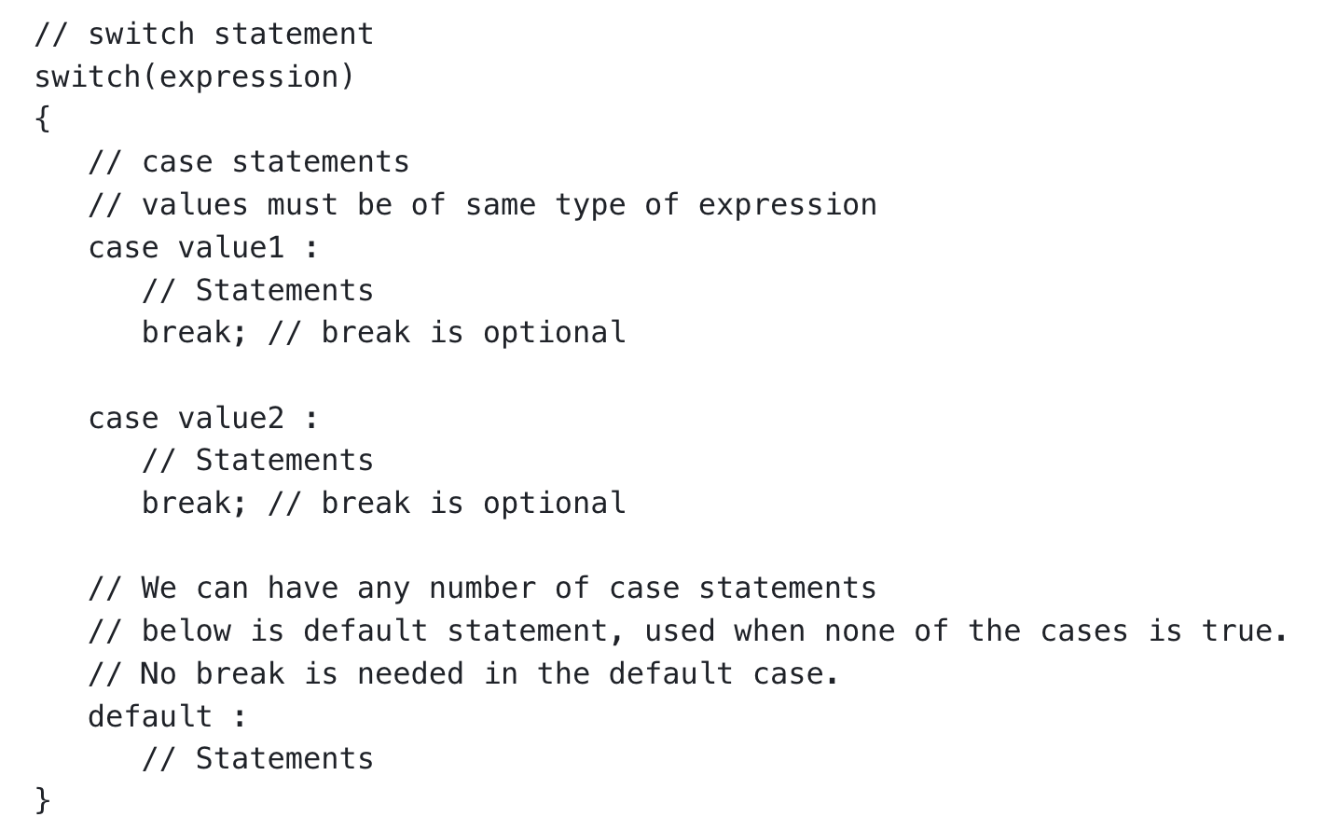
What is switch statement?
Switch statements in Java enable execution of different code blocks based on the value of an expression. They provide an alternative to multiple if-else statements and can be used when an expression can have numerous possible values.

Slide 21
What is an Array?
An array is a collection of items of same data type stored at contiguous memory locations.

Slide 22
Let’s understand few topics of Array
Is the array always of fixed size? How an Array is initialized? How to access elements in Array ?

Slide 23
What is Jagged Array?
A jagged array is an array of arrays such that member arrays can be of different sizes, i.e., we can create a 2-D array but with a variable number of columns in each row. These types of arrays are also known as Jagged arrays

Slide 24
Syntax and example of Jagged Array?
// Declare a jagged array
int[][] jaggedArray = new int[3][]; // 3 rows
// Initialize each row with a different number of columns
jaggedArray[0] = new int[]{1, 2, 3}; // Row 1: {1, 2, 3} (3 columns)
jaggedArray[1] = new int[]{4, 5}; // Row 2: {4, 5} (2 columns)
jaggedArray[2] = new int[]{6, 7, 8, 9}; // Row 3: {6, 7, 8, 9} (4 columns)
In this example, we first declare a jagged array with 3 rows. Then, we initialize each row separately with arrays of different lengths to achieve the jagged structure. Each row can have its own independent length, allowing for flexibility in representing irregular data structures

Slide 25
What is loop in Java
In Java, a loop is a control flow statement that allows a block of code to be executed repeatedly based on a specified condition. There are several types of loops in Java
There are several types of loops in Java
for loop: Executes a block of code a specified number of times.
while loop: Executes a block of code as long as a specified condition is true.
do-while loop: Similar to a while loop, but the block of code is executed at least once, even if the condition is initially false.

Slide 26
Let’s understand for loop in Java with example
for loop: Executes a block of code a specified number of times.
for (int i = 0; i < 5; i++) {
System.out.println("Iteration: " + i);
}

Slide 27
Let’s understand while loops in Java with example
while loop: Executes a block of code as long as a specified condition is true.
int i = 0;
while (i < 5) {
System.out.println("Iteration: " + i);
i++;
}

Slide 28
Let’s understand do while loop in Java with example
do-while loop: Similar to a while loop, but the block of code is executed at least once, even if the condition is initially false.
int i = 0;
do {
System.out.println("Iteration: " + i);
i++;
} while (i < 5);

Slide 29
What is for each loop in java
In Java, the for-each loop, also known as the enhanced for loop, is a special type of loop designed for iterating over arrays and collections. It simplifies the process of iterating through each element of an array or collection without the need for an explicit loop counter or index variable.
Syntax
for (elementType element : array) {
// Code here
}

Slide 30
Thank you

